Slide 1
Canadian Rental Market
Group members :
Sweta Joshi
Sakshi Dalal
Rimple Poonia Dabas

Slide 2
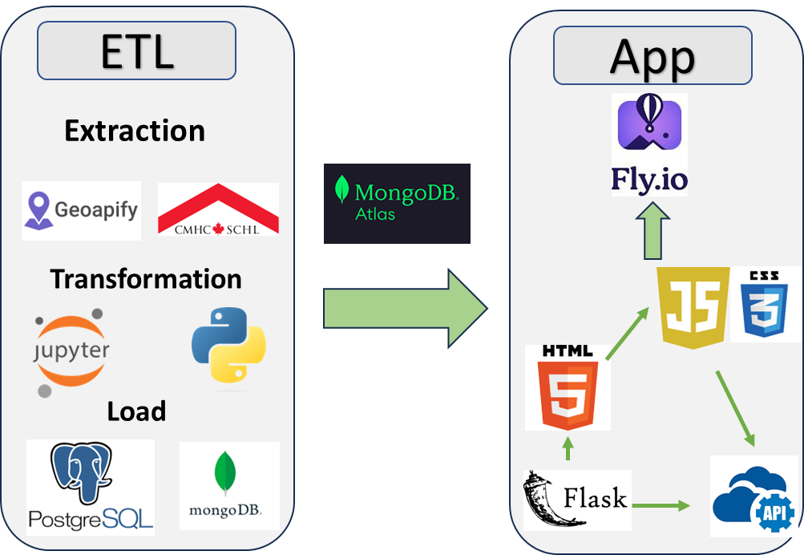
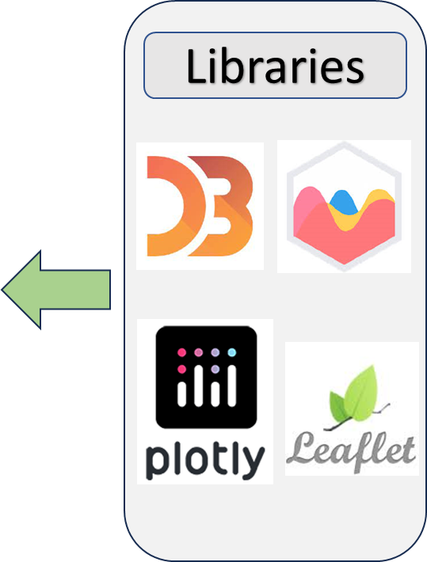
Extract
Transform
Load
App
APP

Slide 3
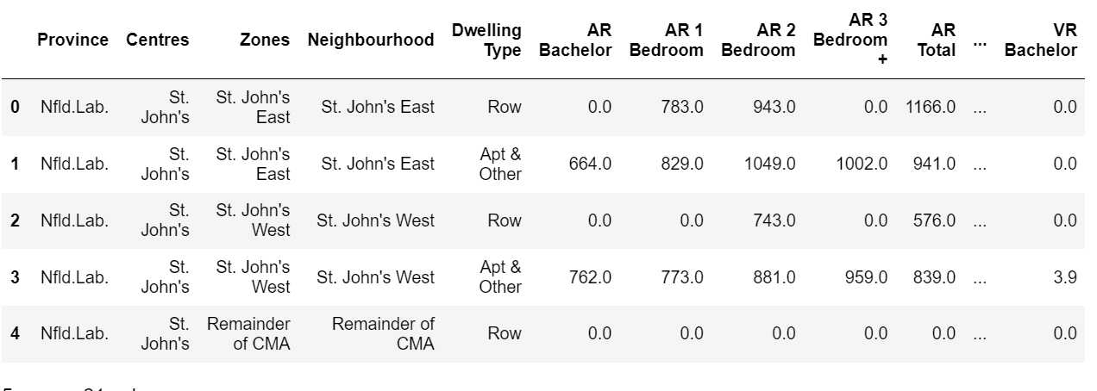

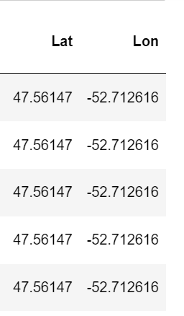

Extract
Transform
Load
App
Data extraction

Slide 4



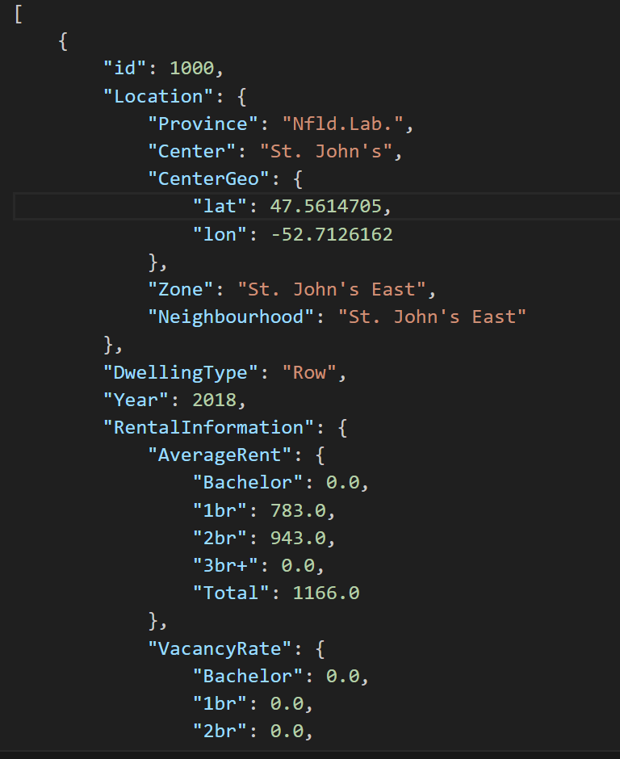
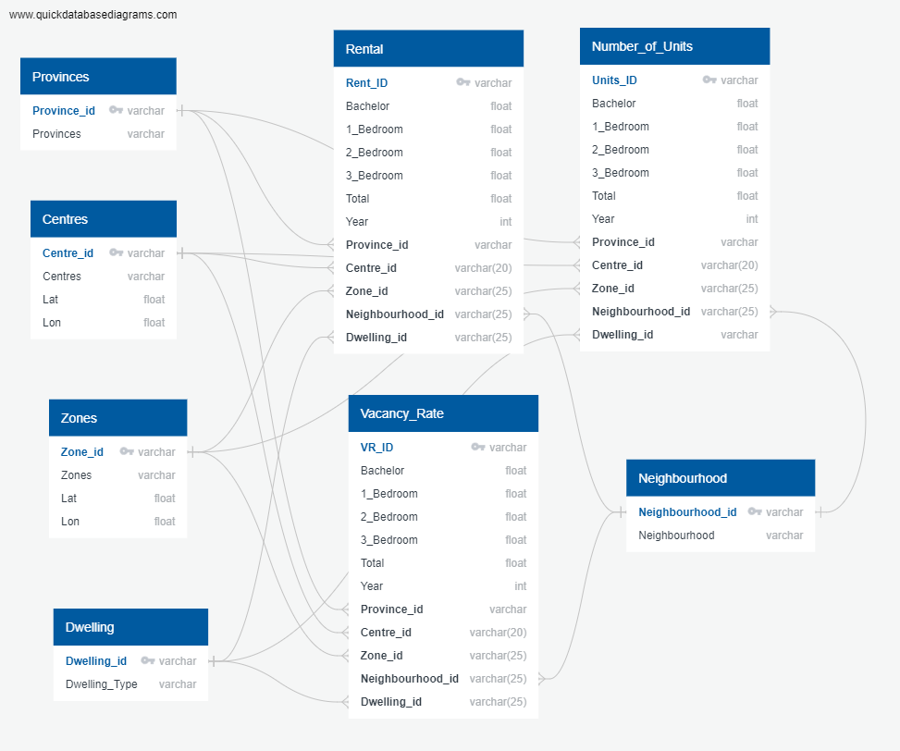
Extract
Transform
Load
App
Data Transformation
Original Data
Json and csv files

Slide 5


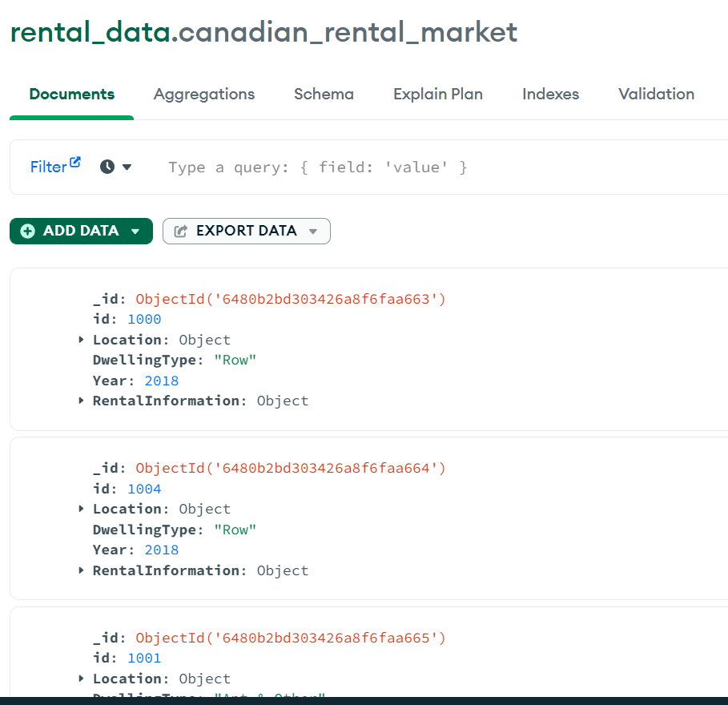
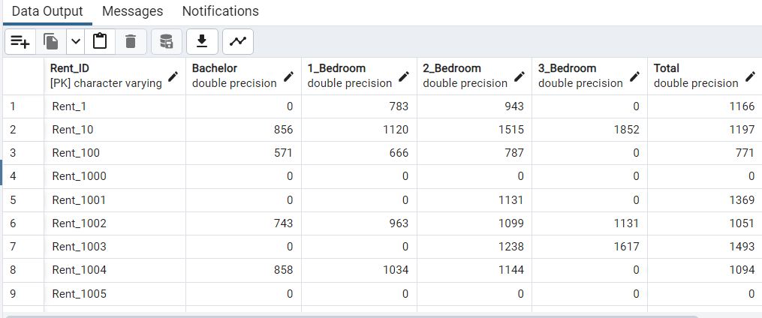
Extract
Transform
Load
App
Data Load
Non-Relational
Relational

Slide 6














ETL
App
Libraries
Extraction
Transformation
Load

Slide 7
